Slide 1
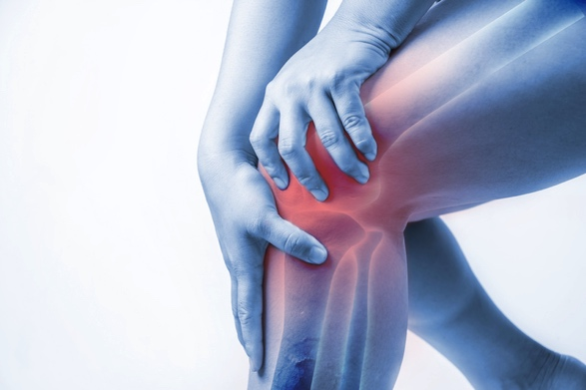
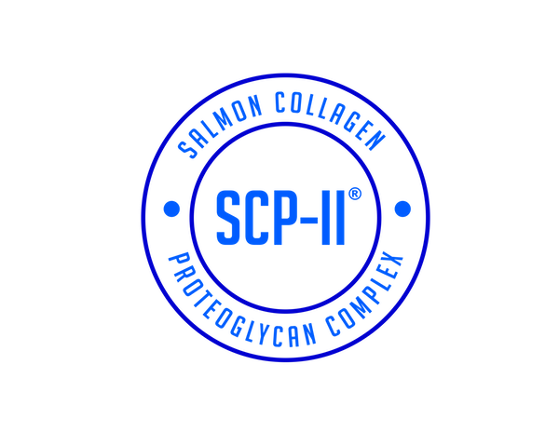
Salmon Type II Collagen Proteoglycan Complex
SCP-II®
The New Generation of Joint and Skin Health
March 2020

Slide 2
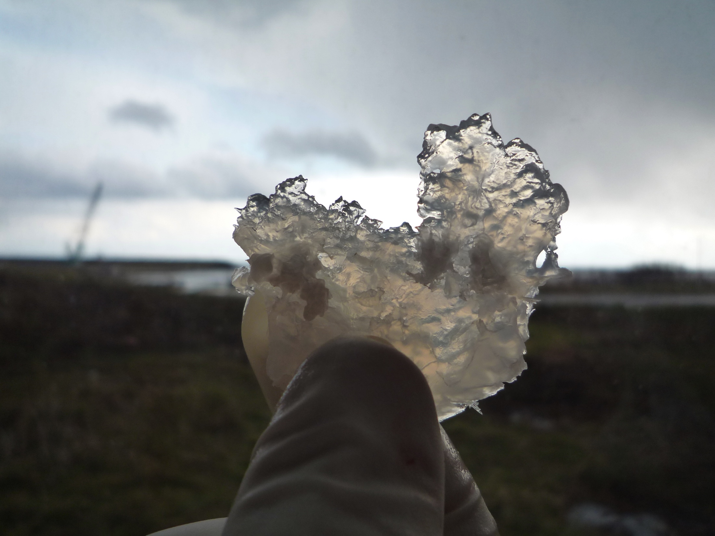
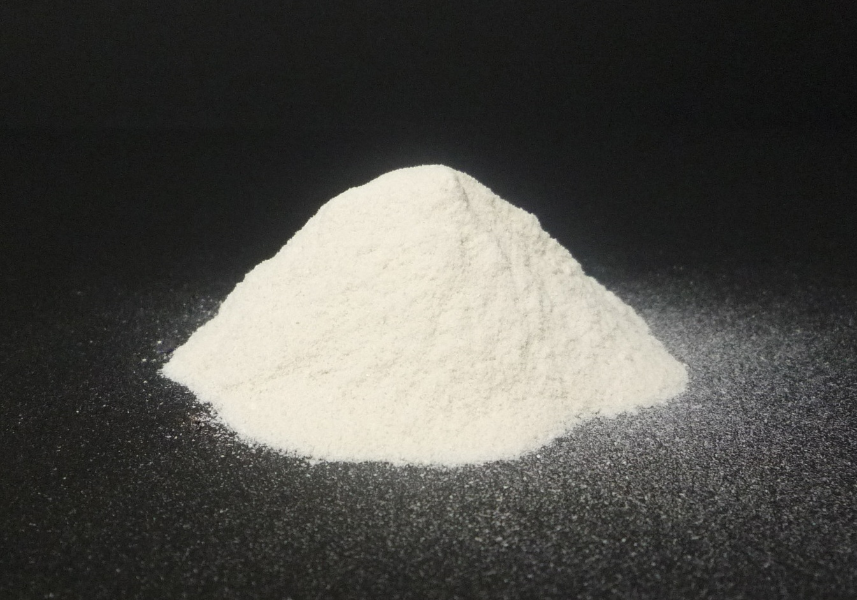
SCP-II® is:
40% undenatured Type II Collagen
38% undenatured Proteoglycan
100% salmon nasal cartilage (naturally extracted from wild-caught salmon, which would otherwise be wasted)
Salmon nasal cartilage has been consumed in Japan for centuries as a delicacy called Hizu-namasu (氷頭)
White/Light Yellow Powder
Tasteless and Odorless
Manufactured in Hokkaido, Japan
No carriers, Non-GMO, Non-Irradiated
Notes:
Extraction using water and NaOH

Slide 3
Anatomy of our Joints
Our joint cartilage is made up of two components: Type II Collagen and Proteoglycan
Chondrocytes are the only cells present in the cartilage and function to generate and degrade Type II Collagen and Proteoglycan.
Notes:
Joint pain and stiffness is a top concern across all generations
With age there is increased collagen degradation, death of cells involved in collagen production, joint damage, joint inflammation

Slide 4
SCP-II® improves knee pain: Human Study
Randomized, double-blind, placebo-controlled study (Yoshida 2016)
60 healthy subjects (40-77yrs) experiencing pain or rigidity in knee
Daily Dose = 50mg SCP-II® (2016)
Control substances:
Glucosamine, Daily Dose = 1500mg/day
Placebo
Efficacy measured by WOMAC questionnaire for pain, stiffness, and functioning of joints and VAS (Visual Analogue Scale) for knee pain
Both WOMAC and VAS results showed a statistically significant decrease in knee pain in SCP-II group compared to Placebo group starting 4 weeks after intake (p<0.01, p<0.05)
SCP-II also showed a greater effect compared to glucosamine intake
Results of VAS score for left knee pain show a statistically large decrease in pain for those that were administered SCP-II (Q) compared to the Placebo group (P) starting from 4 weeks. We also see that this change was more significant than that of the glucosamine (R).
Notes:
WOMAC = Western Ontario and McMaster Universities Osteoarthritis Index. Standardized questionnaire to evaluate condition of patients with osteoarthritis of knee and hip, including pain, stiffness, and physical functioning of the joints.

Slide 5
SCP-II® is a complex of both:
40% undenatured Type II Collagen
38% undenatured Proteoglycan
Both undenatured Type II Collagen and undenatured Proteoglycan have individually shown efficacy in decreasing joint pain
Notes:
Extraction using water and NaOH

Slide 6
Undenatured Type II Collagen
Undenatured Type II Collagen caught attention in the 2000 for its efficacy on joint inflammation.
Currently two human studies on undenatured Type II Collagen (UC-II®)
Lugo, et al 2013 - Undenatured Type II Collagen significantly improved range of bend and stretch of joints of healthy volunteers at 120 days of treatment (n=55)
Lugo, et al 2016 - Undenatured Type II Collagen significantly reduced knee pain in individuals with Osteoarthritis compared to placebo, AND had a greater effect than individuals taking glucosamine + chondroitin at 180 days of treatment (n=191). Glucosamine + chondroitin supplementation failed to have a statistically significant improvement vs. placebo.
Non-human studies show mechanism of action of undenatured Type II Collagen may be its ability to initiate the production of two important anti-inflammatory factors (IL-10 and TGF-β)
Undenatured Type II Collagen has also shown to help chondrocytes build more collagen
Notes:
Zhao 2010: Chicken type II collagen induced immune balance of main subtype of helper T cells in mesenteric lymph node lymphocytes in rats with collagen-induced arthritis

Slide 7
SCP-II more competitive than UC-II
There currently exists an undenatured Type II Collagen product for joint health on the market: UC-II
SCP-II contains 40% Type II Collagen, while UC-II contains only 25% Type II Collagen
SCP-II also contains an additional 38% proteoglycans. UC-II does not contain any proteoglycans.
SCP-II is made from wild-caught salmon nasal cartilage, UC-II comes from chicken sternum cartilage

Slide 8
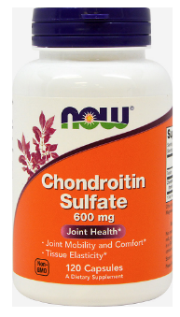
A now available, new ingredient: Proteoglycan
Proteoglycan and Type II Collagen make up the joint cartilage.
Chondroitin sulfate is a popular joint health supplement, but it does not naturally exist in free form in our cartilage but rather attached to a protein core that makes up a proteoglycan.
Proteoglycan excels in its moisture holding abilities, and helps smooth movement of joints by its buffering function.
For many years undenatured proteoglycan was not readily available and too expensive for use. Recently, a patented effective extraction method of proteoglycan was developed, allowing for this new ingredient to enter the market.

Slide 9
Proteoglycan decreases knee pain and discomfort – HUMAN STUDY 1
Randomized, placebo-controlled, double-blind study (Soeda 2016)
31 healthy subjects (40-69yrs) with knee discomfort
Dose = 10mg salmon proteoglycan/day for 12 weeks
VAS score used for knee pain, J-KOOS (Japan-Knee injury and Osteoarthritis Outcome Score) questionnaire used to measure joint discomfort, pain, function, quality of life
RESULTS: Significant decrease in VAS score for knee pain when going up stairs (p<0.05), and improvement in knee extension and flexion (P<0.001) for SP group vs. placebo. The J-KOOS showed that the total scores significantly improved at week 4 and 12 in salmon proteoglycan group compared to placebo. (p<0.05)
Some examples of questions in J-KOOS questionnaire:
How severe is your knee joint stiffness after first wakening in the morning?
How is your pain walking on flat surfaces?
How well are you able to descend stairs? Rise from sitting?

Slide 10
Proteoglycan can improve and prevent knee pain and discomfort – HUMAN STUDY 2
Kuriyama 2017
Randomized, placebo-controlled, double-blind study
66 healthy subjects ages 40 to 70
Dose= 5mg salmon proteoglycan/day for 12 weeks
Efficacy measured using VAS and measuring high sensitive C-reactive protein (hs-CRP)
RESULTS:
Significant difference in VAS score of proteoglycan group compared to placebo at 4 weeks after ingestion, showing effectiveness in improving knee discomfort (p<0.05)
Hs-CRP levels in PG group showed decrease in correlation to the VAS score, showing that the efficacy is most likely caused by the anti-inflammatory action (similar to the mechanism of undenatured Type II Collagen)
Notes:
To evaluate both subjective assessment and anti-inflammatory biomarker, CRP levels increase when there is inflammation in body

Slide 11
Proteoglycan can have a chondroprotective effect on subjects with knee discomfort – HUMAN STUDY 3
Tomonaga 2017
Randomized, placebo-controlled, double-blind study
55 healthy subjects with knee discomfort
Dose= 10mg salmon proteoglycan/day for 16 weeks
Efficacy measured with biomarkers for cartilage metabolism:
Type II Collagen degradation (C1,2C), Type II Collagen synthesis (PIICP)
RESULTS:
In subjects experiencing high levels of pain, C1,2C levels significantly decreased in PG group compared to placebo (p<0.05)
In subjects experiencing constant knee pain, C2,2C levels significantly decreased in PG group compared to placebo (p<0.05)
Therefore, PG may have protective effect on cartilage metabolism in subjects with severe and constant knee pain by lowering Type II Collagen degradation.

Slide 12
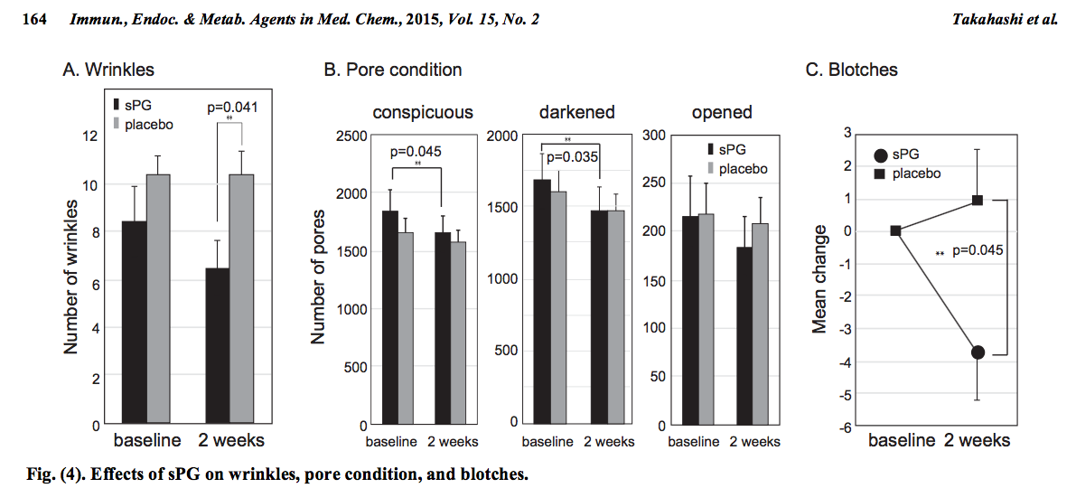
Proteoglycan Improves Skin Health – HUMAN STUDY 4
A randomized, double-blind, placebo-controlled study in 2015 with 19 subjects. Dose was 5mg/day of salmon proteoglycan for 2 weeks. Results of the study showed a significant decrease in wrinkles, pores, blotches, and improvement in skin elasticity and looseness in the test group (sPG).

Slide 13
Non-human studies – Salmon Proteoglycan
PG reduces production of matrix metalloproteinase in cell cultures (an enzyme that contribute to degradation of cartilage)
PG has immunomodulatory and anti-inflammatory effects – reduced autoimmune response in colitis, rheumatoid arthritis, multiple sclerosis models
Promotes wound healing, modulates inflammation, reduces infection
May stimulate production of new chondrocytes → which in turn produces more proteoglycans and collagen
Protect from UV radiation, reduces inflammation, improves hydration

Slide 14
SCP-II has its own safety study
28-Day Repeated Dose Oral Toxicity Study in Rats
Wang 2017
10 male and 10 female rats
Dose of SCP-II was 500mg/kg body weight per day for 4 weeks
RESULTS: No toxicity evidence relevant to test article treatment was observed

Slide 15
Summary of SCP-II benefits
Low dose of 14mg-50mg/day
Demonstrated efficacy in decreasing joint pain
Demonstrated efficacy in improving extension and flexion of knee
Demonstrated efficacy in improving skin health
May support production of collagen and proteoglycan and protect from degradation of cartilage
SCP-II is safe
Is fish sourced rather than chicken sourced

Slide 16
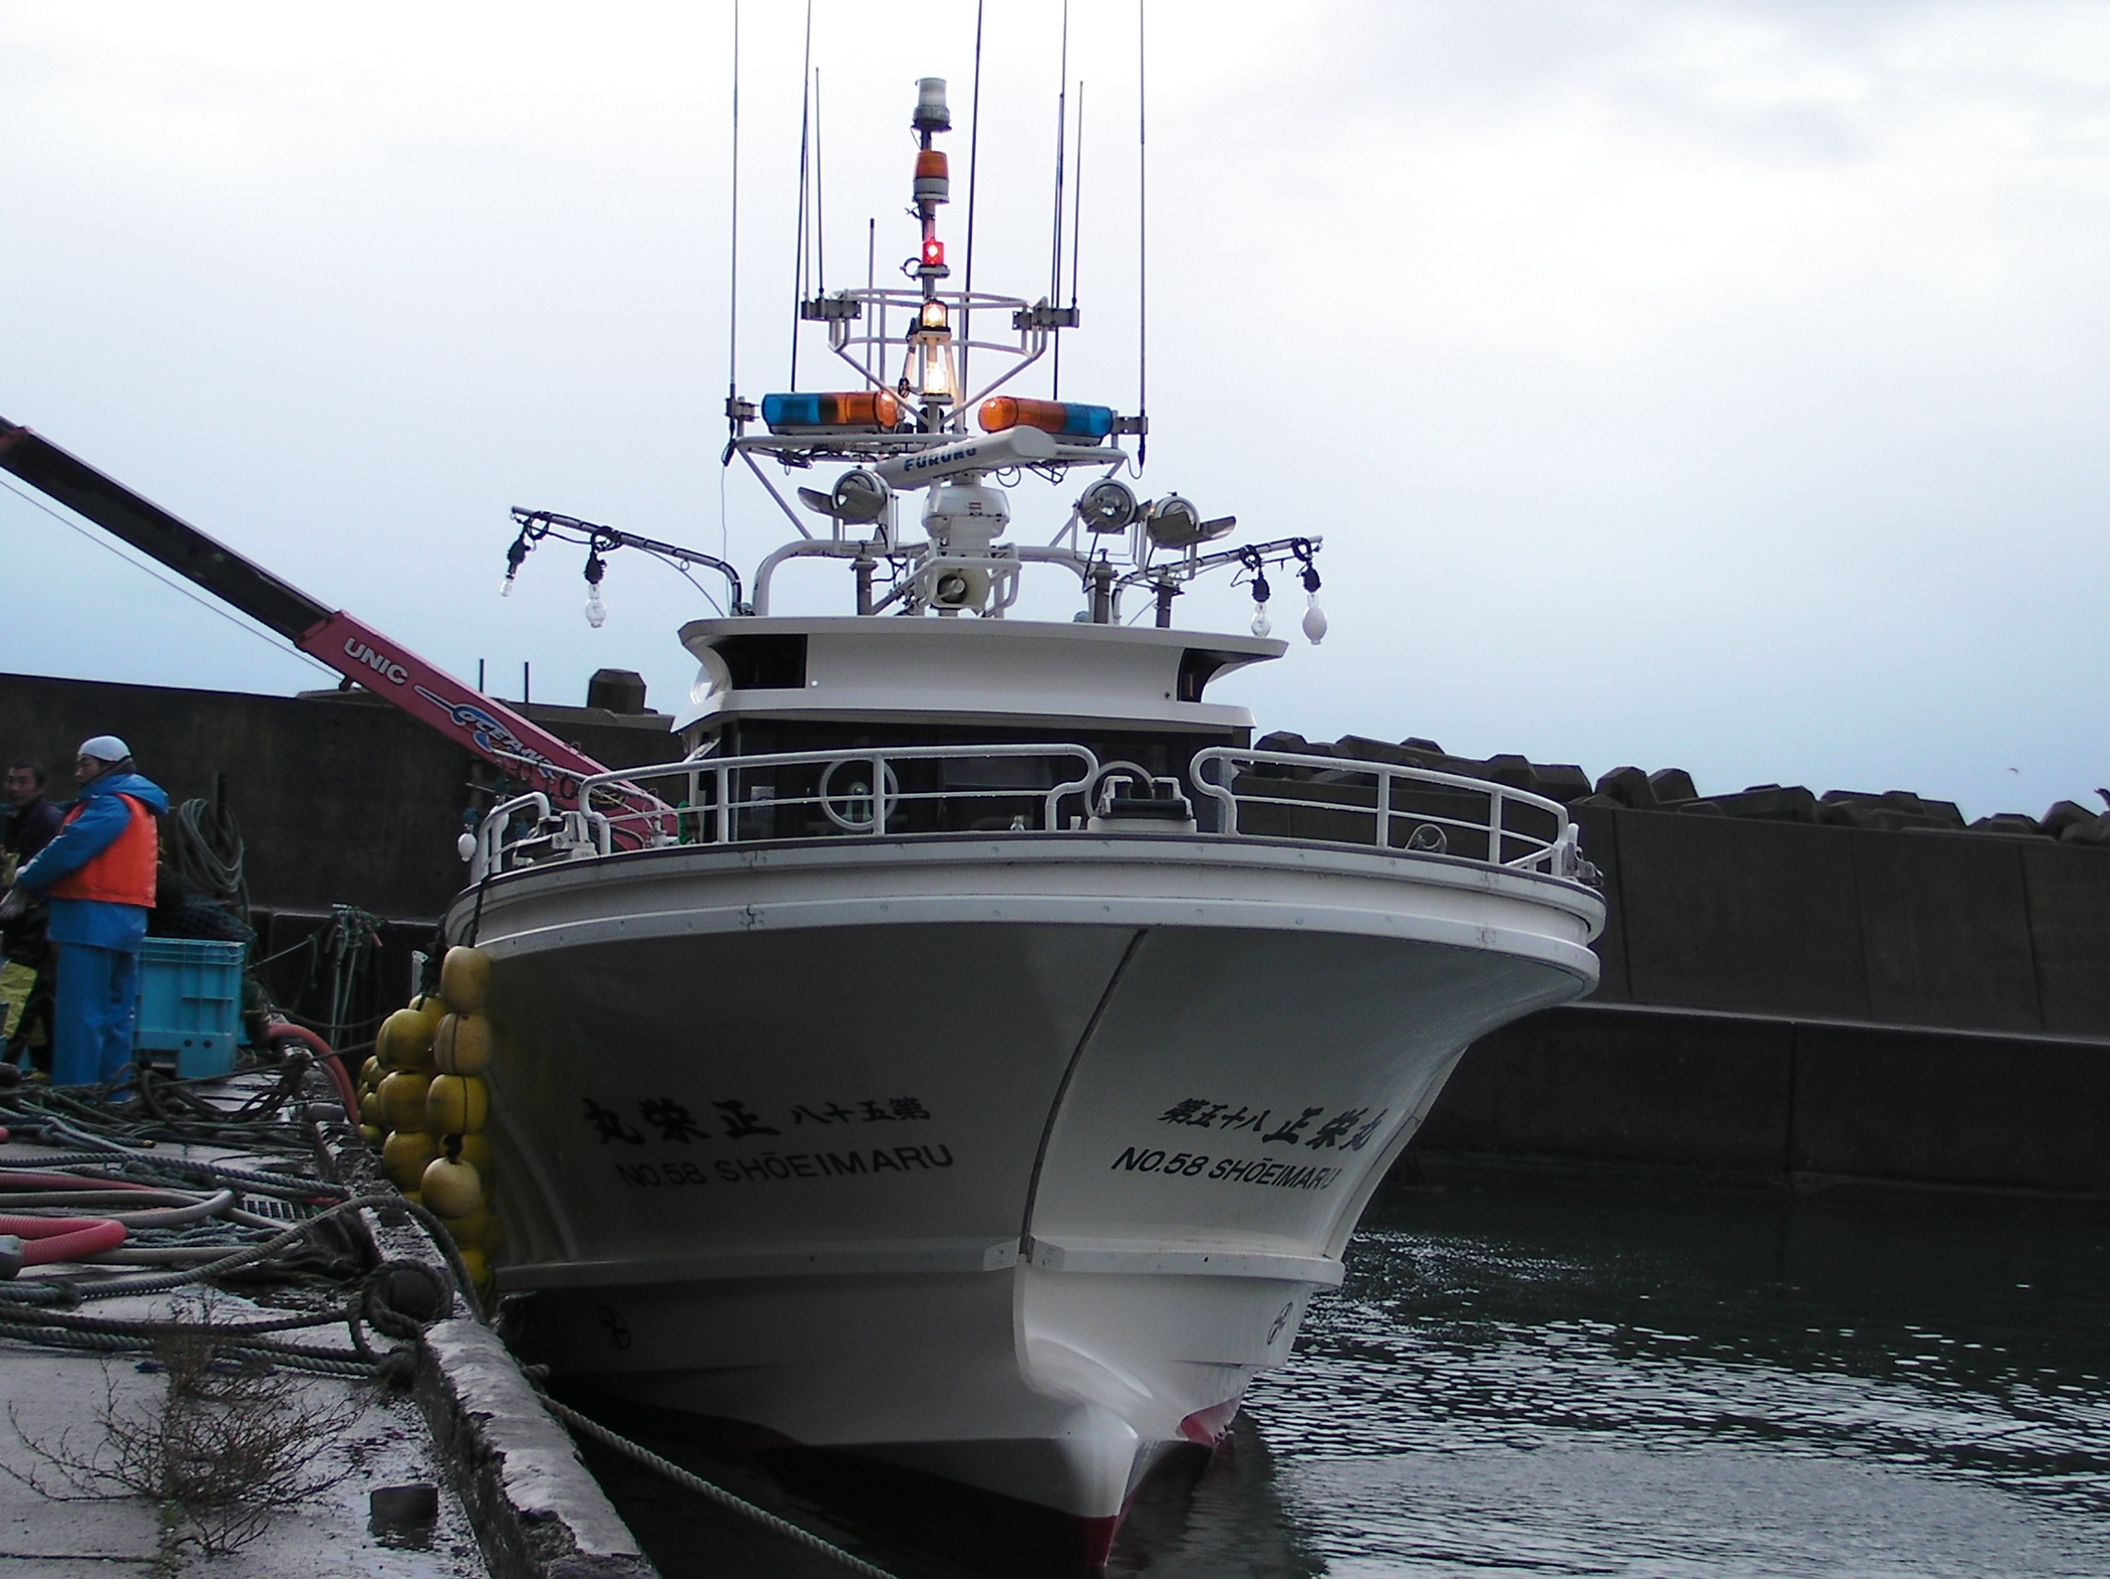
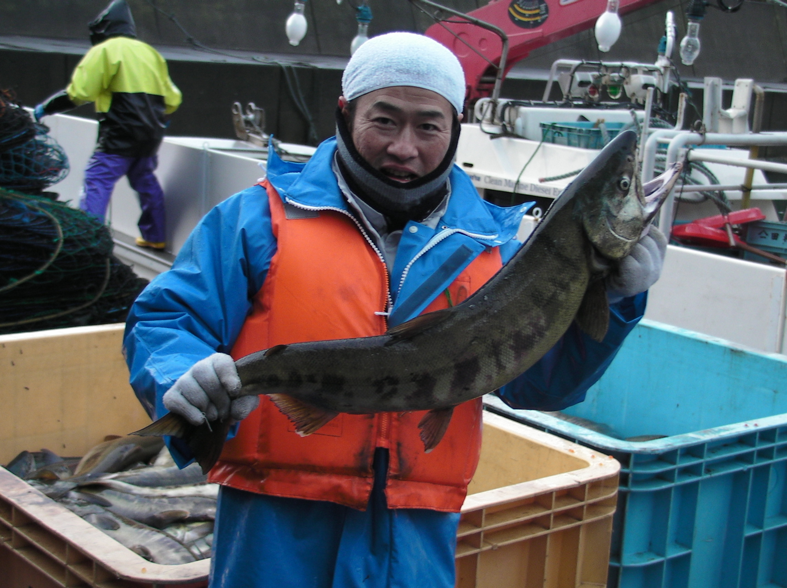
THANK YOU!
Guzen Development, Inc.
sales@guzendevelopment.com
925-938-2724

